Slide 1
RepCut: Superlinear Parallel RTL Simulation with Replication-Aided Partitioning
By Haoyuan Wang, Scott Beamer
Presenter: Boyang Zhang, Department of ECE, UW Madison
bzhang523@wisc.edu

Slide 2
About me
Education
BS in School of Electronic and Information, South China University of Technology, China, 2020.
MS in Department of ECE, Rutgers University, 2021.
Second-year PhD student (supervisor: Prof. Tsung-Wei Huang).
Current research
Incremental task graph partitioning.
A paper^{[1]} of task graph partitioning was accepted to DAC’24.
I am submitting a paper to ICCAD’24.
[1] Boyang Zhang, Dian-Lun Lin, Che Chang, Cheng-Hsiang Chiu, Bojue Wang, Wan Luan Lee, Chih-Chun Chang, Donghao Fang, and Tsung-Wei Huang, "G-PASTA: GPU Accelerated Partitioning Algorithm for Static Timing Analysis," ACM/IEEE Design Automation Conference (DAC), San Francisco, CA, 2024

Slide 3
Outline
Introduction to Register Transfer Level(RTL) simulation
What is RTL simulation?
Why partitioning?
Partitioning challenges?
Introduction to RepCut
Partitioning algorithm walkthrough
Scheduling the partitions
Experimental results
Current research
Limitations of RepCut partitioning
Our partitioning

Slide 4
Introduction to RTL simulation

Slide 5
What is RTL simulation?
A process to simulate the behaviors of a Register Transfer Level(RTL) design to verify its functionality.
Event-driven(more accurate) or full-cycle(less time-consuming).
Full-cycle simulator: Verilator^{[2]}, ESSENT^{[3]}(unoptimized).
[2] https://github.com/verilator/verilator
[3] https://github.com/ucsc-vama/essent
Notes:
So, what is RTL simulation?
It is a process to simulate the behaviors of a Register Transfer Level design to verify the design’s functionality and correctness
RTL simulator can be mainly classified as 2 types, event-driven RTL simulator and full-cycle RTL simulator.
An event-driven simulator takes each change of the input stimulus as an event and propagate this value changes through the circuit.
A full-cycle simulator is oblivious to the changes of input stimulus within one cycle and only stimulates the design once per cycle.
So in a word, an event-driven simulator gives more accurate simulation results but when it comes to very large circuit design, full cycle RTL simulator is much faster.
In this paper, we focus on full-cycle RTL simulator and there are 2 full-cycle RTL simulators that are evaluated in this paper, Verilator, and ESSENT.
More specifically, the partitioning method introduced by RepCut is operated in an unoptimized version of ESSENT to demonstrate its effectiveness verses the baseline partitioning
method in Verilator, which we will talk a bit more in experimental results.

Slide 6
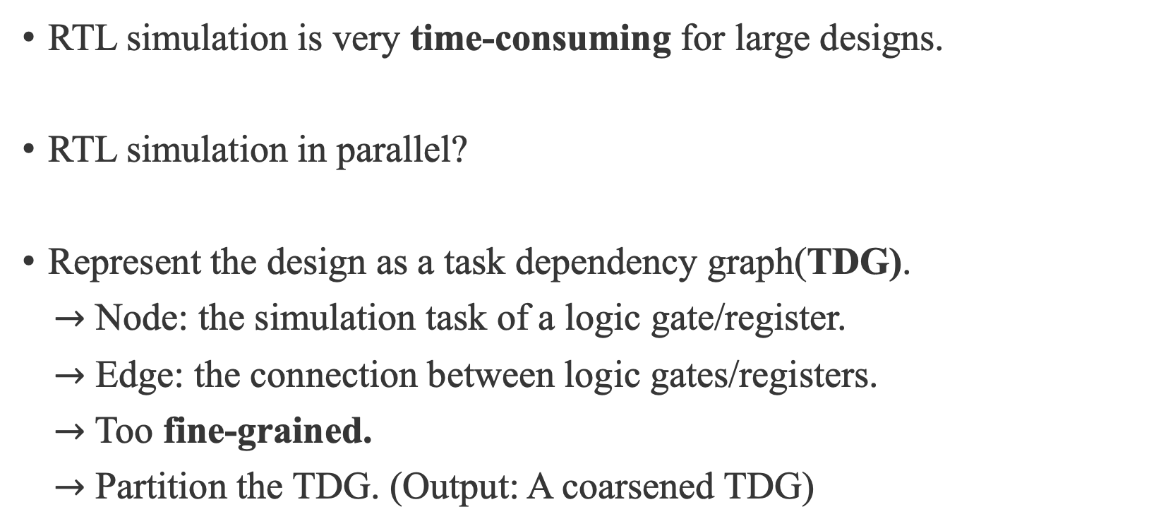
Why partitioning?
RTL simulation is very time-consuming for large designs.
RTL simulation in parallel?
Represent the design as a task dependency graph(TDG).
$→$ Node: the simulation task of a logic gate/register.
$→$ Edge: the connection between logic gates/registers.
$→$ Too fine-grained.
$→$ Partition the TDG. (Output: A coarsened TDG)
Notes:
So, this paper talks about partitioning in RTL simulation.
First, we need to answer a question, why do we need partitioning in RTL simulations.
Well, RTL simulation is very time-consuming when it comes to large designs even for a full-cycle simulator.
For a very large design that contains millions or billions of gates, RTL simulation can be bottleneck in the whole circuit design process.
So how to speedup this simulation process, well naturally we will think about maybe we can do it in parallel.
A typical first step to do RTL simulation in parallel is to represent the hardware design as a TDG, which is a task dependency graph.
TDG is essentially a dependency acyclic graph.
For TDGs in RTL simulation, each node represents a simulation task of a register or a logic gate that we want to test in the design.
Each edge represents the connections among these logic gates and registers.
With TDGs, we can distribute each simulation task to CPU/GPU threads to do them in parallel.
But, as I said, the circuits can contain billions of gates, and such fine-grained distribution of tasks is just too overwhelming to CPU or even GPU!
To solve this issue, we can coarsen the TDG by partitioning it.
Partitioning a TDG here is to cluster multiple gates or registers into one partition, or one task.
After this, we can distribute the partitions to either CPU/GPU threads to achieve RTL simulations in parallel.

Slide 7
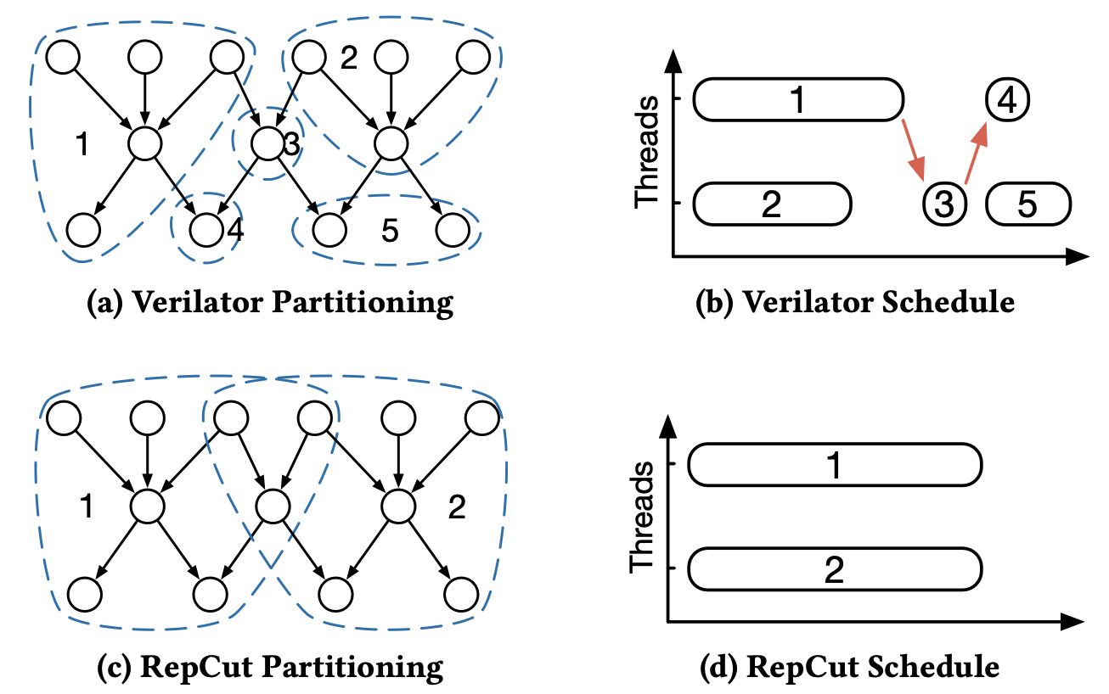






Partitioning challenges?
Goal: Balanced partitions and minimal synchronization effort.
$$sync$$
$$one simulation cycle$$
$$sync$$
$$sync$$
$$sync$$
$$one simulation cycle$$
Notes:
Now, what are the challenges for partitioning such a TDG in RTL simulations?
To understand the challenges for partitioning here, let me first bring up our goal here for the partitioning.
Ideally, we want our partitions to be balanced and by balanced I mean the number of tasks within a partition should be roughly the same.
And we want to have minimal synchronization effort within a simulation cycle. Ultimately, all the threads should only synchronize once at the end of the simulation cycle.
Now, let’s look into the 4 figures here to understand why we want such a goal for partitioning.
In this figures, figures A and C shows the same TDG but they are applied with different partitioning methods.
Figure A shows the partitioning method in the baseline Verilator and figure C shows the partitioning method introduced by RepCut.
Figure B and D shows the scheduling, or the distributions, as I mentioned in the last slides, of partitions to the threads for Verilator partitioning and RepCut partitioning accordingly.
The impact of these 2 different partitioning methods to the runtime of RTL simulations is quite obvious here in this example.
Figure B shows that if we apply Verilator partitioning in this example, threads will need to synchronize 3 times.
Meanwhile Figure D tells us if we apply RepCut partitioning, we are not only able to synchronize only once but also able to finish one simulation cycle faster.
Also, comparing figure B and D, we can clearly see that Verilator provides a very unbalanced partitioning results which cause the threads being idling, the so-called bubbles in simulation process.
While RepCut provides a perfectly balanced partitioning results with all the threads running the entire time within the simulation cycle.
So what’s the magic RepCut is doing here? In figure C, RepCut is replicating the overlapping tasks between partition 1 and partition 2 so that when they are being executed by the threads, they don’t have
to wait for each other but only need to synchronize once at the end of the simulation cycle.

Slide 8
Introduction to RepCut

Slide 9
Introduction to RepCut
An example of RepCut partitioning.
Schedule the partitions.
Experimental results.
Notes:
And in the remaining slides, I will reveal RepCut’s magic on how it performs its partitioning by walking through an example in the paper.
I would also talk about how RepCut schedule the partitions to the threads to do RTL simulations in parallel.
Finally, I would present the experimental results.

Slide 10
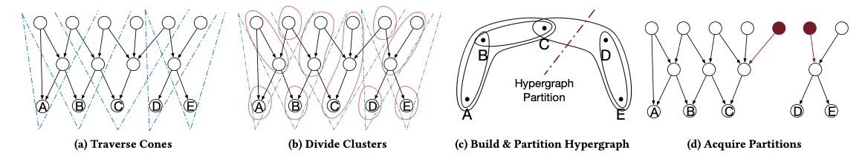

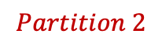

Introduction to RepCut – An example
Input: A fine-grained TDG.
Output: A coarsened TDG.
$→$ Build “cones”.
$→$ Coarsen the graph.
$→$ Build hypergraph and partition.
$→$ Acquire partitions.
$$Partition 1$$
$$Partition 2$$
Notes:
Now, let’s dive into an example of how RepCut performs its partitioning method to a TDG.
Again, the input of a partitioning method for TDG, is a fine-grained TDG. As is shown in the left most figure A here, each task represents the simulation task of a register or logic gate and each edge represents their connections.
The output of a partitioning method for TDG, is a coarsened TDG. As is shown in the right most figure D here. Through RepCut, we have divided the TDG into 2 partitions.
All the tasks in the left are included in partition 1 and all the tasks in the right are included in partition 2.
RepCut’s partitioning method contains 4 steps, which are shown in the below figures from left to right.
We first build the so-called cones in the graph. Then we cluster the graph according to the cones we built.
Then we build a hypergraph according to the clusters and called a hypergraph partitioner to partition it.
Finally, we acquired our desired partitions from the hypergraph partitioning results.

Slide 11
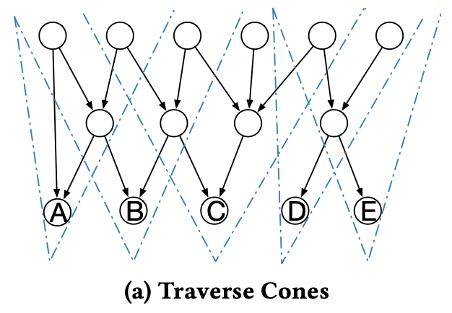
Introduction to RepCut – Build “Cones”
Start from sink nodes, traverse nodes within its ”cone”.
Notes:
Now, let’s talk about how RepCut build the cones in this TDG.
First, we need to find all the sink nodes in the TDG.
In this case, we have sink nodes A, B, C, D and E.
Each sink node leads a cone.
Then we traverse the TDG in a bottom up fashion from each sink nodes to all the dependent nodes that we can reach to build the cones.
In this example, after the traversal, we will have built 5 cones since we have 5 sink nodes.

Slide 12
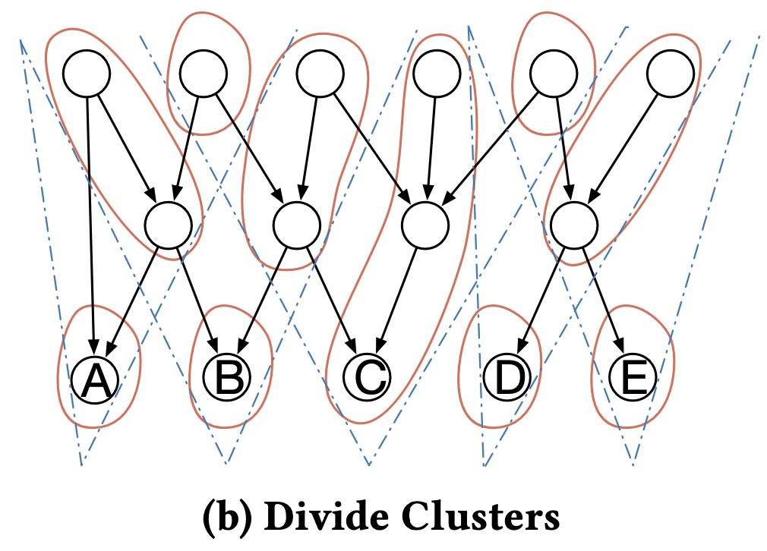










Partitioning Walkthrough – Coarsen the graph
Cluster nodes according to ”cones”.
$$ABC$$
$$BC$$
$$CDE$$
$$E$$
$$AB$$
$$A$$
$$B$$
$$C$$
$$D$$
$$E$$
Notes:
After we have built the cones. We then can coarsen the graph by clustering the nodes into different partitions according to the cones we built.
For example, for these 2 nodes covered in grey color (talk about partition AB), they are included in both cone A and cone B. So, they should be clustered into the same partition. Let’s call this partition partition AB here.

Slide 13
Partitioning Walkthrough – Coarsen the graph
Cluster nodes according to ”cones”.
$$ABC$$
$$BC$$
$$CDE$$
$$E$$
$$AB$$
$$A$$
$$B$$
$$C$$
$$D$$
$$E$$
Notes:
And for these 2 nodes covered in grey(talk about partition BC), they are included in both cone B and cone C. So, they should be clustered into the same partition partition BC here.

Slide 14
Partitioning Walkthrough – Coarsen the graph
Cluster nodes according to ”cones”.
$$ABC$$
$$BC$$
$$CDE$$
$$E$$
$$AB$$
$$A$$
$$B$$
$$C$$
$$D$$
$$E$$
Notes:
And for this single node covered in grey, it is the only node that is included in all cone A, cone B and cone C, so this node itself, will be a partition partition ABC.

Slide 15
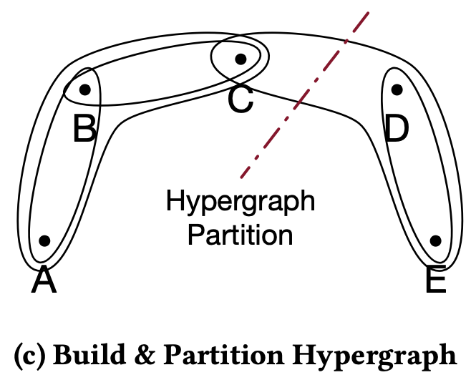









Partitioning Walkthrough – Build hypergraph
Build hypergraph according to clusters.
$$ABC$$
$$BC$$
$$CDE$$
$$E$$
$$AB$$
$$A$$
$$B$$
$$C$$
$$D$$
$$E$$
Notes:
After we have coarsened the graph into different partitions or clusters, we can build a hypergraph according to the clusters.
One reason why RepCut introduces hypergraph here is that comparing to normal graph where each edge shows the connection between a pair of nodes, a hyperedge in a hypergraph shows the connections among a set of nodes.
And this is such a good fit here since a hyperedge can simulate a net in the circuit that connects multiple gates or registers.
Now, let’s talk about how we can build the hypergraph in figure C from figure B.
First, the sink nodes A, B, C, D and E in figure B are all represented as vertices in hypergraph in figure C.
And the hyperedges in figure C represents the non-sink clusters in figure B.
For example, we have a non-sink cluster cluster AB here. That means we will have a hyperedge between vertex A and vertex B in figure C.
We also have a non-sink cluster cluster ABC here. That means we will have a hyperedge between vertex A, vertex B and vertex C in figure C.
By applying this transformation to all the clusters in figure B, we can obtain the hypergraph in figure C and try to partition it.
Notice RepCut actually includes 2 partitioning process here. The first partitioning process is used to coarsen the origin TDG.
The second partitioning process is applied to hypergraph to help us acquire the final replication result.

Slide 16
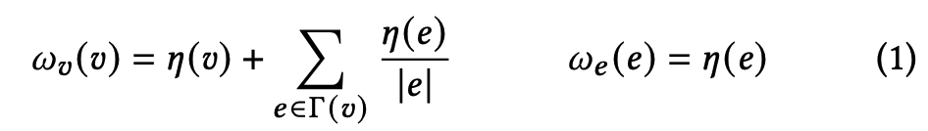
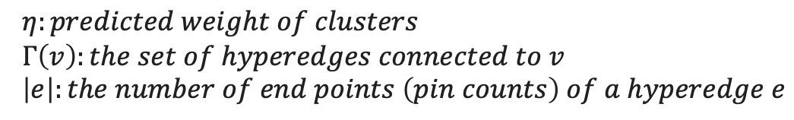
Partitioning Walkthrough – Partition hypergraph
Partition the hypergraph using Kahypar^{[4]}.
$$η:predicted weight of clusters$$
$$Γ\left(v\right):the set of hyperedges connected to v$$
$$\left|e\right|:the number of end points \left(pin counts\right) of a hyperedge e$$
[4] https://kahypar.org
Notes:
𝜂 (eta) $Γ$ (gemma)
Now let’s see how RepCut partitions the hypergraph shown in figure C.
RepCut utilize a state-of-the-art hypergraph partitioner Kahypar to partition the generated hypergraph.
Since it is using an existing hypergraph partitioner, the innovation of RepCut lies in how it define the weights of vertices and hyperedges in the hypergraph.
Here formula (1) shows how RepCut defines the weight of vertices wv on the left and the weight of hyperedges we on the right.

Slide 17
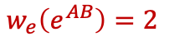

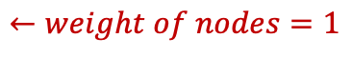
Partitioning Walkthrough – Partition hypergraph
Partition the hypergraph using Kahypar^{[4]}.
$$AB$$
$$←weight of nodes=1$$
$$η:predicted weight of clusters$$
$$Γ\left(v\right):the set of hyperedges connected to v$$
$$\left|e\right|:the number of end points \left(pin counts\right) of a hyperedge e$$
$$w_{e}\left(e^{AB}\right)=2$$
[4] https://kahypar.org
Notes:
𝜂 (eta) $Γ$ (gemma)
Now let me give you a couple of examples to understand how to calculate wv and we.
First we look at figure B, we assume that the weight of the nodes in figure B are all equal to 1.
Notice that we can always give a better weight assumptions to nodes in figure B in practice depending on applications.
But for simplicity, let’s define their weight as integer 1 here.
Let’s talk about the weight of hyperedges we first. Here the weight of a hyperedge is equal to eta e.
eta e here is defined as the weight of a cluster.
In figure B, cluster AB covered in grey color has the weight of 2 as it contains 2 nodes.
So the weight of hyperedge eAB in figure C is equal to 2.

Slide 18


Partitioning Walkthrough – Partition hypergraph
Partition the hypergraph using Kahypar^{[4]}.
$$ABC$$
$$←weight of nodes=1$$
$$η:predicted weight of clusters$$
$$Γ\left(v\right):the set of hyperedges connected to v$$
$$\left|e\right|:the number of end points \left(pin counts\right) of a hyperedge e$$
$$w_{e}\left(e^{AB}\right)=2$$
$$w_{e}\left(e^{ABC}\right)=1$$
[4] https://kahypar.org
Notes:
𝜂 (eta) $Γ$ (gemma)
And cluster ABC covered in grey color has the weight of 1 as it only contains 1 node.
So, hyperedge ABC in figure c has the weight of 1.

Slide 19
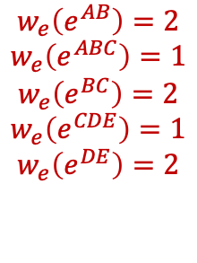


Partitioning Walkthrough – Partition hypergraph
Partition the hypergraph using Kahypar^{[4]}.
$$←weight of nodes=1$$
$$η:predicted weight of clusters$$
$$Γ\left(v\right):the set of hyperedges connected to v$$
$$\left|e\right|:the number of end points \left(pin counts\right) of a hyperedge e$$
$$weight of itself$$
$$sum of proportional share in hyperedges$$
$$w_{e}\left(e^{AB}\right)=2$$
$$w_{e}\left(e^{ABC}\right)=1$$
$$w_{e}\left(e^{BC}\right)=2$$
$$w_{e}\left(e^{CDE}\right)=1$$
$$w_{e}\left(e^{DE}\right)=2$$
[4] https://kahypar.org
Notes:
𝜂 (eta) $Γ$ (gemma)
Applying this formula to all the non-sink clusters in figure B, we will have the weight of all the hyperedges shown at the bottom.
Now let’s see how to calculate the weight of a vertex in hypergraph.
The weight of a vertex wv contains 2 parts, the weight of the sink cluster itself in figure B and the sum of its proportional share in hyperedges.

Slide 20
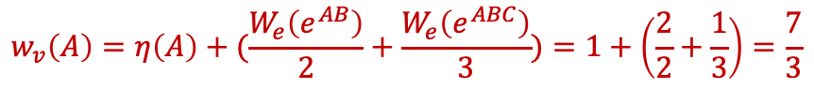
Partitioning Walkthrough – Partition hypergraph
Partition the hypergraph using Kahypar^{[4]}.
$$←weight of nodes=1$$
$$η:predicted weight of clusters$$
$$Γ\left(v\right):the set of hyperedges connected to v$$
$$\left|e\right|:the number of end points \left(pin counts\right) of a hyperedge e$$
$$weight of itself$$
$$sum of proportional share in hyperedges$$
$$w_{v}\left(A\right)=η\left(A\right)+(\frac{W_{e}\left(e^{AB}\right)}{2}+\frac{W_{e}\left(e^{ABC}\right)}{3})=1+\left(\frac{2}{2}+\frac{1}{3}\right)=\frac{7}{3}$$
$$w_{e}\left(e^{AB}\right)=2$$
$$w_{e}\left(e^{ABC}\right)=1$$
$$w_{e}\left(e^{BC}\right)=2$$
$$w_{e}\left(e^{CDE}\right)=1$$
$$w_{e}\left(e^{DE}\right)=2$$
[4] https://kahypar.org
Notes:
𝜂 (eta) $Γ$ (gemma)
Take a look at vertex A in figure C.
Its weight should be, the first part, the weight of itself in figure B, which is the weight of cluster A colored in grey in figure B, 1.
Plus the sum of its proportional share in its all connected hyperedges.
In this example, vertex A is connected to 2 hyperedges, hyperedge AB and hyperedge ABC.
The proportional share of vertex A in hyperedge AB should be the weight of hyperedge AB, which is 2, divided by the number of end points of hyperedge AB, which is 2.
So the proportional share of vertex A in hyperedge AB is 1.
Same thing is applied to hyperedge ABC.
The weight of hyperedge ABC is 1. And it has 3 end points, ABC. So vertex A will get a share of weight, 1 divided by 3.
Sum them together, we will get the final weight of vertex A as 7 divided by 3.

Slide 21
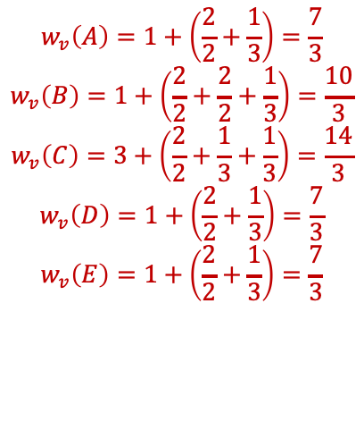
Partitioning Walkthrough – Partition hypergraph
Partition the hypergraph using Kahypar^{[4]}.
$$←weight of nodes=1$$
$$η:predicted weight of clusters$$
$$Γ\left(v\right):the set of hyperedges connected to v$$
$$\left|e\right|:the number of end points \left(pin counts\right) of a hyperedge e$$
$$weight of itself$$
$$sum of proportional share in hyperedges$$
$$w_{v}\left(A\right)=1+\left(\frac{2}{2}+\frac{1}{3}\right)=\frac{7}{3}$$
$$w_{v}\left(B\right)=1+\left(\frac{2}{2}+\frac{2}{2}+\frac{1}{3}\right)=\frac{10}{3}$$
$$w_{v}\left(C\right)=3+\left(\frac{2}{2}+\frac{1}{3}+\frac{1}{3}\right)=\frac{14}{3}$$
$$w_{v}\left(D\right)=1+\left(\frac{2}{2}+\frac{1}{3}\right)=\frac{7}{3}$$
$$w_{v}\left(E\right)=1+\left(\frac{2}{2}+\frac{1}{3}\right)=\frac{7}{3}$$
$$w_{e}\left(e^{AB}\right)=2$$
$$w_{e}\left(e^{ABC}\right)=1$$
$$w_{e}\left(e^{BC}\right)=2$$
$$w_{e}\left(e^{CDE}\right)=1$$
$$w_{e}\left(e^{DE}\right)=2$$
[4] https://kahypar.org
Notes:
𝜂 (eta) $Γ$ (gemma)
Apply this formula to all the vertices in hypergraph and we will have their weight results shown as below.

Slide 22

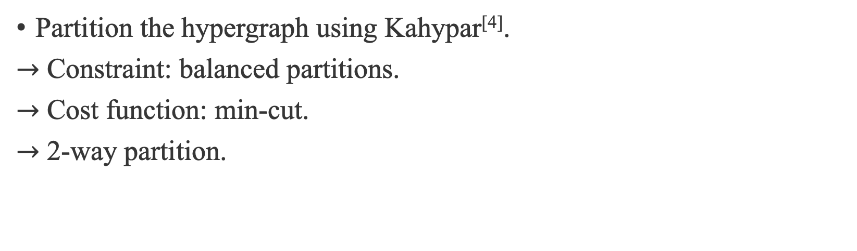

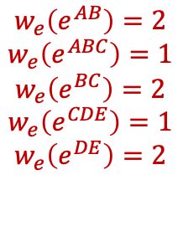
Partitioning Walkthrough – Partition hypergraph
Partition the hypergraph using Kahypar^{[4]}.
$→$ Constraint: balanced partitions.
$→$ Cost function: min-cut.
$→$ 2-way partition.
$$w_{v}\left(A\right)=1+\left(\frac{2}{2}+\frac{1}{3}\right)=\frac{7}{3}$$
$$w_{v}\left(B\right)=1+\left(\frac{2}{2}+\frac{2}{2}+\frac{1}{3}\right)=\frac{10}{3}$$
$$w_{v}\left(C\right)=3+\left(\frac{2}{2}+\frac{1}{3}+\frac{1}{3}\right)=\frac{14}{3}$$
$$w_{v}\left(D\right)=1+\left(\frac{2}{2}+\frac{1}{3}\right)=\frac{7}{3}$$
$$w_{v}\left(E\right)=1+\left(\frac{2}{2}+\frac{1}{3}\right)=\frac{7}{3}$$
$$w_{e}\left(e^{AB}\right)=2$$
$$w_{e}\left(e^{ABC}\right)=1$$
$$w_{e}\left(e^{BC}\right)=2$$
$$w_{e}\left(e^{CDE}\right)=1$$
$$w_{e}\left(e^{DE}\right)=2$$
$$Kahypar$$
[4] https://kahypar.org
Notes:
𝜂 (eta) $Γ$ (gemma)
And finally, with all the weights calculated, we input the hypergraph in figure C and the weights of hyperedges and vertices into the hypergraph partitioner, Kahypar to do hypergraph partitioning.
The hypergraph partition will have a constrain of balanced partitions.
It will also apply the partitioning under the cost function, minimum cut, which means we want the sum of weights of the hyperedges including in the cut to be as small as possible.
And assume we want 2 partitions. The partitioning result is shown as a cut edge in figure C.

Slide 23
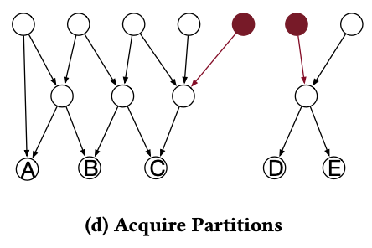


Partitioning Walkthrough – Acquire partitions
Acquire the final partitions by replicating the nodes in cut edge.
$$CDE$$
$$CDE$$
$$CDE$$
Notes:
𝜂 (eta) $Γ$ (gemma)
Now, let’s see how do we obtained the final partitioned TDG based on the hypergraph partitioning results.
And the idea is pretty straightforward.
We just need to replicating all the nodes in the clusters cut by the cut edge in hypergraph.
Here in this example, the cut edge in figure C cut the hyperedge CDE, and that is the cluster CDE in figure B.
So, we just need to replicate all the nodes in the cluster CDE and maintain the same topology for the replicating part in each partition.
Then we are done!

Slide 24


Partitioning Walkthrough – Acquire partitions
Acquire the final partitions by replicating the nodes in cut edge.
$→$ Our goal: Balanced partitions and minimal synchronization effort.
$→$ Constraint: balanced partitions.
$→$ Cost function: min-cut.
$$sync$$
$$sync$$
Notes:
𝜂 (eta) $Γ$ (gemma)
Now before we move onto the scheduling part.
Let’s remind ourselves what is the goal of our partitioning and take a look at why transforming this TDG partitioning problem into a hypergraph partitioning will help us to achieve this goal.
Again, our goal, first, is to have balanced partitions so that when scheduling these partitions to threads, we can avoid, or reduce the situations that the threads being idle during the RTL simulation.
And hypergraph partitioning has the exact same constraint to give us a balanced partition.

Slide 25

Partitioning Walkthrough – Acquire partitions
Acquire the final partitions by replicating the nodes in cut edge.
$→$ Our goal: Balanced partitions and minimal synchronization effort.
$→$ Constraint: balanced partitions.
$→$ Cost function: min-cut. $→$ minimize replication cost.
$$sync$$
Notes:
𝜂 (eta) $Γ$ (gemma)
What about minimal synchronization effort?
Of course, a balanced partitioning result will contribute to less synchronization.
But even with a balanced partitioning results, it is still possible that we need to synchronize multiple times when executing the TDG from source to sink.
The innovation of RepCut is: it tries to cut the TDG bottom up completely into multiple partitions so that all threads will only need to synchronize at the end of the execution.
And such a complete cut comes with a cost, and that is the cost of replication.
And since we are only replicating the nodes including in the cut in hypergraph, we can represent the replication cost with the weight of cut edges.
And amazingly, after we build up such connection between the cost of the cut and the cost of replication, the cost function of minimum cut in hypergraph partitioning will help us to minimize the replication cost.
And that’s why RepCut transforms a TDG partitioning problem to a hypergraph partitioning problem.
It tries to achieve a balanced partitioning results and minimal synchronization effort with minimal replication cost.

Slide 26
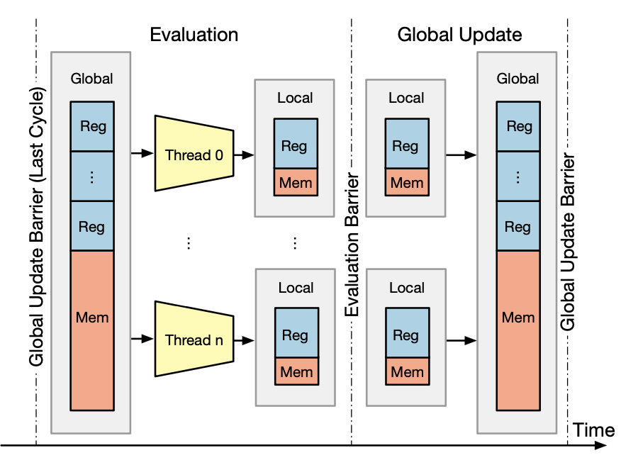

Schedule the partitions
Divide the circuit into multiple regions.
$→$ Boundary: registers and memory.
Apply partitioning to each region.
Schedule the partitions.
Notes:
Now let’s talk about how RepCut schedules the partitions to threads to do RTL simulations.
The scheduling part is pretty standard.
RepCut will divide the circuits into multiple regions and the boundaries of each region are registers and memory.
And within the region are all those combinational logics.
RepCut applies its partitioning method to each region and schedule the partitions to all the threads.
The resulting data of each partition will be first stored in a local memory.
And after the execution of all the partitions are finished. And that is to say, all the data in local memory is obtained.
RepCut will do a global update to update the data in local memory to the global memory.

Slide 27
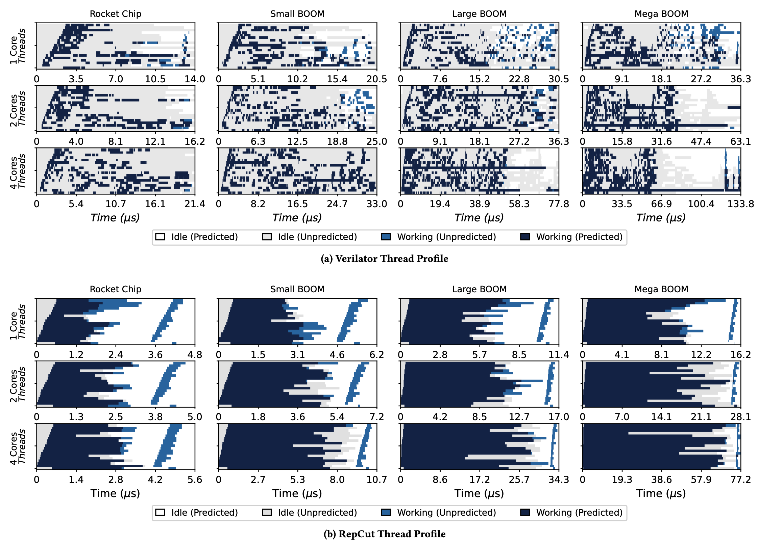
Experimental results – Balanced partitions
ESSENT (RepCut) vs Verilator (Vivek’s^{[5]})
[5] Sarkar, Vivek. Partitioning and
scheduling parallel programs
for execution on multiprocessors.
Stanford University, 1987.
Notes:
And for experimental results, RepCut is applied in ESSENT RTL simulator.
And the comparator, is the another RTL simulator Verilator.
Notice that Verilator utilizes a different partitioning method introduced by professor Vivek from Geotech in his PhD dissertation back in standford.
The experiments here shows the profile of threads execution during the RTL simulations.
The horizontal axis indicate the time and vertical axis indicate different threads.
The authors utilize 4 benchmarks here as 4 columns.
The white and grey color in the figures indicate the threads being idling.
And the blue and dark blue color indicates the threads being working.
The upper 12 figures are the results from Verilator using Vivek’s partitioning.
The below 12 figures are the results from ESSENT using RepCut’s partitioning.
As we can clearly see, Vivek’s partitioning method introduces quite a lot threads idling known as bubbles in the RTL simulation process.
And this is mainly caused by unbalanced partitioning results.
While RepCut helps to keep all the threads busy for most of time during execution thanks to its balanced partitioning results.

Slide 28
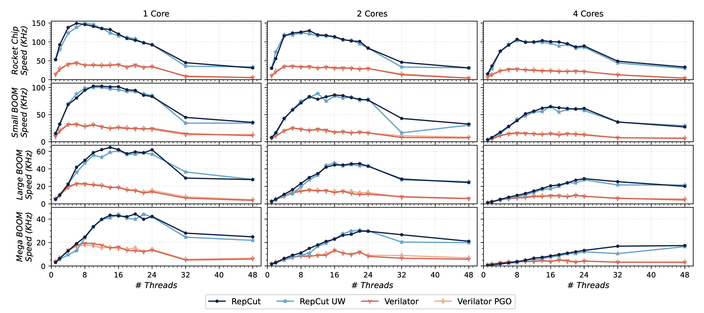
Experimental results – Overall speed of RTL simulation
ESSENT (RepCut) vs Verilator (Vivek’s^{[5]})
[5] Sarkar, Vivek. Partitioning and
scheduling parallel programs
for execution on multiprocessors.
Stanford University, 1987.
Notes:
And the next figures shows the results of overall speed of RTL simulation.
We have 4 comparators here. RepCut and RepCut’s UW, which is a less optimized version of RepCut. And they are shown in blue and light blue color.
And we have Verilator and its more optimized varient Verilator PGO which can provide more accurate RTL runtime predictions. They are shown in orange and light orange color.
The horizontal axis of the figures shows the number of threads used.
The vertical axis shows the frequency of RTL simulations.
As we can see in the figures, ESSENT applied with RepCut enjoys higher simulation frequency than Verilator applied with Vivek’s.

Slide 29
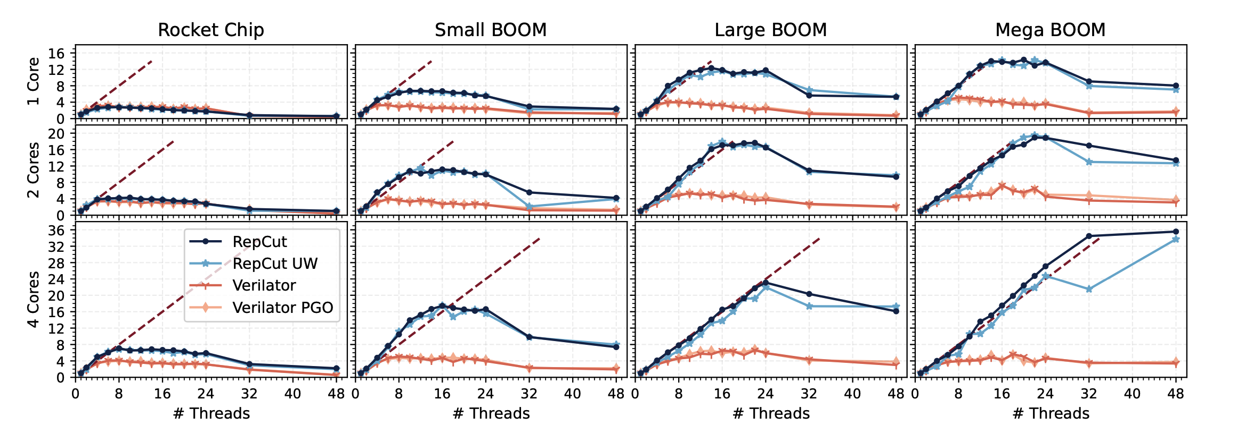
Experimental results – Speedup over itself
ESSENT (RepCut) vs Verilator (Vivek’s^{[5]})
[5] Sarkar, Vivek. Partitioning and
scheduling parallel programs
for execution on multiprocessors.
Stanford University, 1987.
Notes:
And finally, for fair comparison, the authors also compare the speedup over itself after the partitioning for ESSENT and Verilator.
Still, ESSENT with RepCut are shown in blue colors and Verilator with Vivek’s are shown in orange colors.
The horizontal axis shows the number of threads.
The vertical axis shows the amount of speedup over itself.
Overall, we can see that even for comparing with itself, RepCut brings more speedup to ESSENT than the amount of speedup that Vivek’s brings to Verilator.

Slide 30
My current research
Notes:
Now I will introduce a bit about my current research.

Slide 31
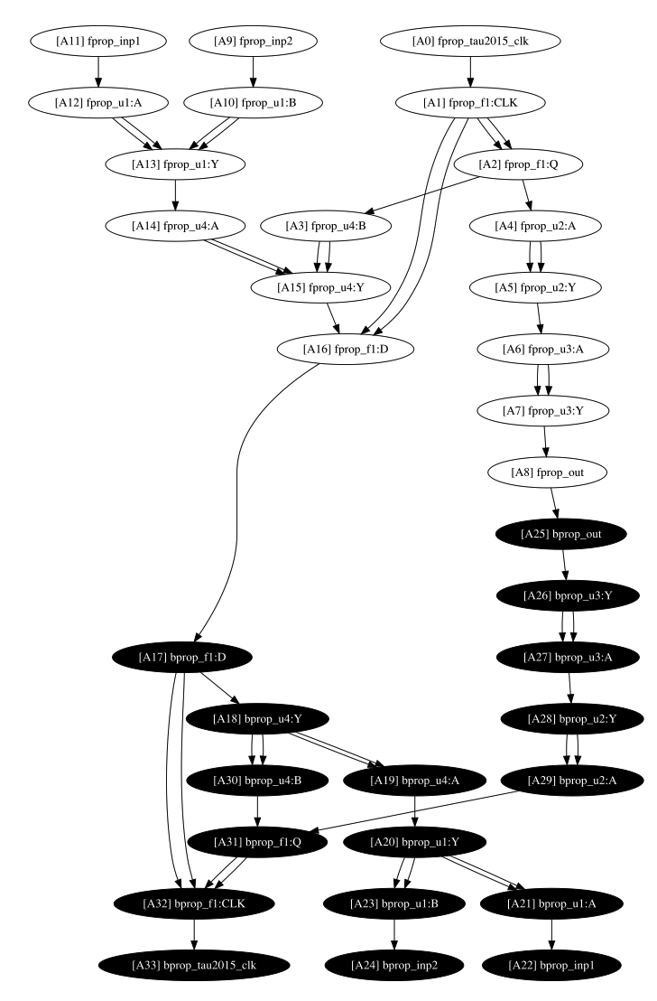


Limitations of RepCut
$A TDG in OpenTimer$^{[6]}
High replication cost.
$→$ TDGs with a long critical path.
Large partitioning overhead.
$→$ TDGs can change each iteration.
$→$ Invoke external hypergraph partitioner.
$→$ Single-thread partitioning.
[6] Huang, Tsung-Wei & Guo, Guannan & Lin, Chun-Xun & Wong, Martin. (2020). OpenTimer v2: A New Parallel Incremental Timing Analysis Engine. IEEE Transactions on Computer-Aided Design of Integrated Circuits and Systems. PP. 1-1. 10.1109/TCAD.2020.3007319.
Notes:
My current research also focus on TDG partitioning.
In our research, we also try to use a TDG to represent a hardware circuit design to try to do static timing analysis in parallel.
And we also have the need to partition the TDG for the same reason I talked before, our graph is too fine-grained.
At first, we tried to implement RepCut to partition our TDG and after the implementation, we found there are 2 major limitations of RepCut partitioning. And its limitations really show up in our static timing analysis application scenarios.
The first limitation is that when we have a TDG with a long critical path, the replication cost is just too high to ignore.
For example, this is a figure of a TDG example in static timing analysis scenarios in OpenTimer.
OpenTimer is a state-of-the-art static timing analysis tool.
In this TDG, the nodes covered in red color are the nodes that may be replicated after RepCut’s partitioning.
No matter how we cut the hypergraph, there are still too many nodes we need to replicate.
The second limitation is the partitioning runtime. The authors didn’t really mentioned the partitioning runtime in the paper.
And this makes sense, because in RTL simulations, often times we only need to partition the TDG once and we will run the same TDG for many iterations.
Thus, the partitioning runtime can be ignored. But in static timing analysis, the TDG can change each iteration.
That means we need to do partitioning each iteration. In this case, the partitioning runtime cannot be ignored.
In fact, based on our experiments, implementing RepCut in OpenTimer, the benefit of partitioning is almost wiped out by the large partitioning overhead.
And this overhead mainly comes from (1) it invokes external hypergraph partition. (2) Its partitioning process is limited by single thread execution.

Slide 32

Our research
TDG partitioning in parallel?
$→$ Put it on GPU^{[1]}.
Incrementally update TDG partitions?
[1] Boyang Zhang, Dian-Lun Lin, Che Chang, Cheng-Hsiang Chiu, Bojue Wang, Wan Luan Lee, Chih-Chun Chang, Donghao Fang, and Tsung-Wei Huang, "G-PASTA: GPU Accelerated Partitioning Algorithm for Static Timing Analysis," ACM/IEEE Design Automation Conference (DAC), San Francisco, CA, 2024
Notes:
So for our research, we come up with our own partitioning method for TDG especially TDGs with a long critical path.
And because our partitioning method has a very friendly nature of parallel execution.
We managed to put it on GPU to largely reduce its runtime and this result is accepted by DAC’24.
Then we are thinking how can we speed up the partitioning even more?
We found that in lots of cases in static timing analysis, during each iteration, the TDG only changes a little bit.
For example, less than 10 nodes or edges are inserted or deleted.
In these situations, maybe it is unnecessary to run the partitioning all over again.
Instead, we can just update the current partitioning results by clustering the newly inserted nodes into the current partitions.
And that is the thing we been working on.

Slide 33
Conclusion
We introduced RTL simulations.
We introduced RepCut’s partitioning methods.
We talked about RepCut’s limitations.
We summarized our research.

Slide 34
Reference
[1] Boyang Zhang, Dian-Lun Lin, Che Chang, Cheng-Hsiang Chiu, Bojue Wang, Wan Luan Lee, Chih-Chun Chang, Donghao Fang, and Tsung-Wei Huang, "G-PASTA: GPU Accelerated Partitioning Algorithm for Static Timing Analysis," ACM/IEEE Design Automation Conference (DAC), San Francisco, CA, 2024
[2] https://github.com/verilator/verilator
[3] https://github.com/ucsc-vama/essent
[4] https://kahypar.org
[5] Sarkar, Vivek. Partitioning and scheduling parallel programs for execution on multiprocessors. Stanford University, 1987.
[6] Huang, Tsung-Wei & Guo, Guannan & Lin, Chun-Xun & Wong, Martin. (2020). OpenTimer v2: A New Parallel Incremental Timing Analysis Engine. IEEE Transactions on Computer-Aided Design of Integrated Circuits and Systems. PP. 1-1. 10.1109/TCAD.2020.3007319.

